Slide 1
Graphic Design
Principles for Enhancing Visual Communication

Slide 2
Reminders
Virtual project workday Friday
Revised prototypes due after break (25%)

Slide 3
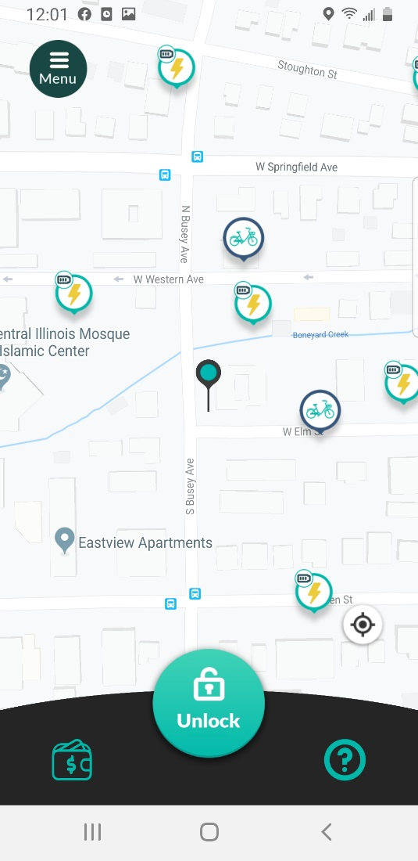
Visual Design
Communicates additional meaning
Groups, prioritizes, and unifies
Conveys positive first impression
Makes you stand out!
Screen from VeoRide service.
Notes:
Visual design refers to the choices made for the visual attributes of the components and content on a user interface screen, including color, size, position, shape, icons and the typeface.
Good visual design:
Communicates meaning beyond the content itself. For example, without knowing anything about the service, we can infer that Unlock is the main task. We can infer that there are two categories of bikes for rent: traditional and electric. The repeated color links the two categories of bikes and Unlock together; the user can infer that the unlock action applies to both categories of bikes.
Size and position is used to prioritize specific actions, in this case Unlock. The background of the menu and lower action area use the same color to unify the action space, despite being in different positions. These elements feel connected.
Conveys a positive first impression and improves the professionalism of a user interface. This is critical because the visual design is what users first notice about a UI. If its confusing or has bad aesthetic, a user might project that negative opinion onto the service itself.
Makes you stand out! You will do visual design: user interfaces, data visualizations, resumes, personal web sites, slide decks and posters are all examples where you will grapple with visual design choices. Applying some basic design principles, even if only those discussed today, will make you stand out from the crowd (especially in engineering)

Slide 4
Learning Goals
Organize on-screen elements according to rules of composition to achieve desired outcomes.
2
Critique a graphical user interface based on visual design principles.
3
Determine the best visual variables and values to achieve communication goals.
1
Notes:
User interfaces, posters, data visualization, slide presentations, diagrams, web pages, and resumes. You will do visual design.
Applying what we discuss today will do wonders.

Slide 5

Learning a written language is a process of learning the elements (alphabet), how to compose the elements (words), and the rules of composition (grammar).
Image from https://momlovesbest.com/reading-for-kids
Notes:
When we learn how to read and write, we first learn the elements of the written language, the alphabet. We then learn how to compose letters to form words and then learn the rules for how to compose the words to form sentences.

Slide 6
Visual Language (for UIs)
Elements such as text, icons, images, and components
Variables such as size, shape, position, and color.
Composition rules such as repetition, contrast, and balance.
Notes:
We can also think of visual design as a language: The language has elements and these elements can be composed through rules of composition to communicate meaning.
A visual language is analogous to written language. A visual language has three components:
1. Design elements (in UI design, images, text, components)
2. Visual variable (attributes such as size, shape, hue, brightness, etc)
3. Rules of composition.
We will focus on understanding the visual variables and compositional guidelines.

Slide 7
Visual Variables
Based on the paper by Robert Roth. Visual Variables. The International Encyclopedia of Geography (edited by Richardson et al.), 2017.
Notes:
There will be overlap with Gestalt Theory: keep in mind these derived form two different fields of study: Gestalt from psychology, visual variables from cartography

Slide 8
Six Visual Variables for Graphical Elements
position
size
shape
orientation
value
hue
Notes:
A visual variable is a variable that can be modified to affect the interpretation of the content it represents. These variables were first described by Jacques (Jock) Bertin in the domain of cartography (map making) and were later adapted for on-screen information displays such as user interfaces and data visualizations.
Position: The X,Y location of an element relative to a coordinate frame.
Size: The amount of space assigned to an element (e.g., as determined by its length or area)
Shape: Describes the external form of an element.
Orientation: Change the rotation or alignment of an element
Value: Refers to the brightness of an element ranging from light to dark
Hue: is the color hue (or the dominant wavelength) of an element at a specific brightness value
Present these six attributes because they are most common for user interface design. Additional attributes include texture, transparency, resolution, and crispness but I won’t have time to cover them.

Slide 9
Perceptual Tasks
A visual variable can be manipulated to affect how well a user can perform perceptual tasks in an information display.
Tasks: select, associate, and order
Notes:
These six variables are processed perceptually rather than “understood” cognitively. We can apply these visual variables in a user interface to aid perceptual tasks. Tasks include selection (making specific elements stand out), association (associate elements as belonging to the same group), and ordering (creating more or less relationships between elements). This is not an exhaustive list will focus on these three tasks for lecture. These tasks overlap with Gestalt Theory but grew out of the field of mapmaking rather than psychology.

Slide 10
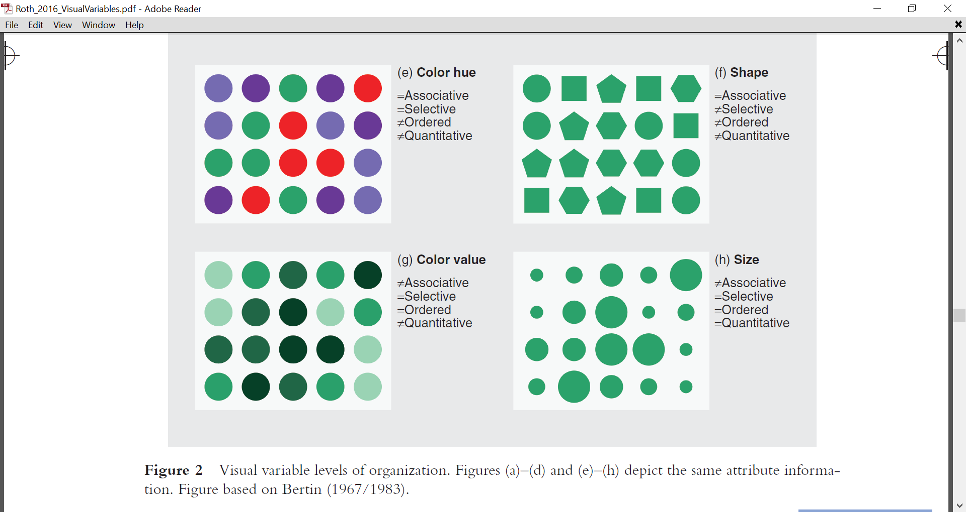
Hue
Value
Size
A variable is Selective if elements with the same value for the variable are perceived as different compared to elements with different values for that same variable. Hue, value, size, position (n.s.) and orientation (n.s.) are selective. In the images, can you select the red, darkest, and largest elements?
Notes:
Elements with the same value for a variable are perceived as different compared to elements with different values for that variable. Use selectivity to make elements stand out.

Slide 11
Shape is considered not Selective or partially selective (e.g., it is difficult to perceive all the hexagons).
Notes:
Shape is considered non-selective or partially selective because it loses its selectivity when there are many distractors (e.g., imagine picking out all the hexagons from many different shapes). Shape is not as useful compared to the other variables for communicating patterns in a user interface. Combine shape with hue for the best effect, for example.

Slide 12
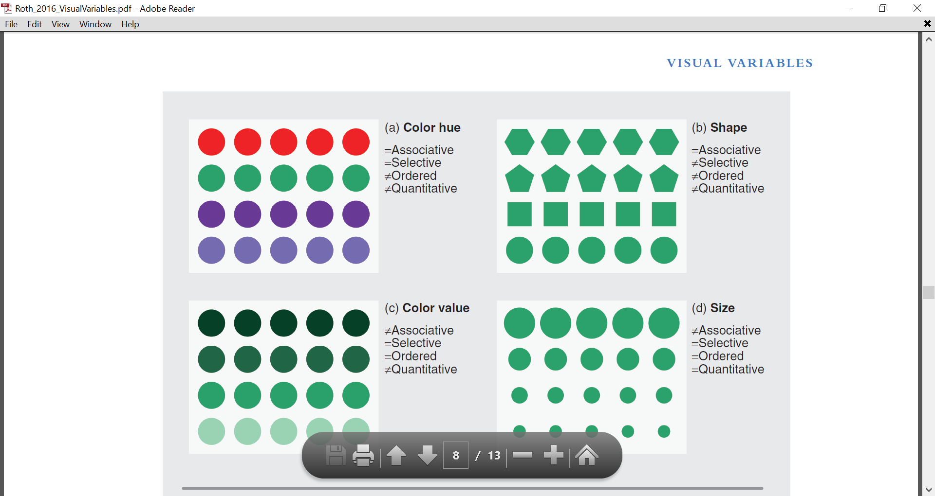
Shape
Hue
Orientation
A variable is Associative if elements with the same value are perceived as a group and with equal weight compared to elements with different values for that variable. Shape, hue, orientation and position (n.s.) are associative. You should perceive different groups in each image all with equal weight.
Notes:
Elements with the same value for the variable are perceived as a group and with equal weight compared to elements with different values for that same variable. Perceive as groups, but nothing stands out more than the others (unlike selectivity).

Slide 13
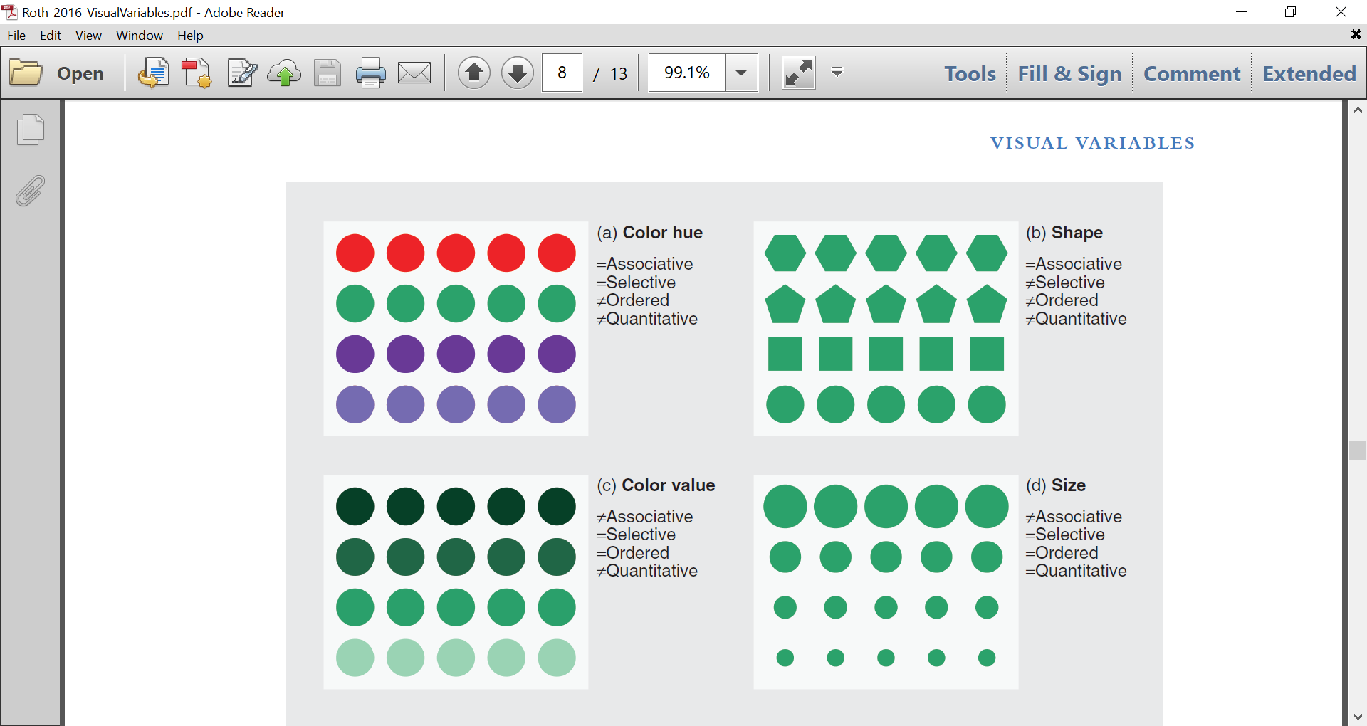
Value
Size
Value and size are not Associative because the groups are perceived with unequal weight (e.g., some groups draw your eye more than others).
Notes:
The eye weighs the darker and the larger circles more than the other groupings. Not equal weight. Not associative.

Slide 14
Value
Size
A variable is Ordered if different values for the variable support ranking of the elements. Value, size, and position (n.s., assumes a scale) are ordered. You should be able to identify elements that represent “more” and “less” in the images.
Notes:
Different values for the variable support ranking (greater or less than) of the elements.

Slide 15
Hue
Shape
Orientation
Hue*, shape and orientation are not Ordered (e.g., difficult to identify which elements represent more and less).
* = used in specific contexts.
Notes:
Sometimes hue is used for temperature scales. It works in that specific context because it relies on feeling of warmth in the color spectrum. That is the exception rather than the rule. For example, if we mapped the same color scheme to say, student scores in the course, it would not map to any specific ordering of the scores.

Slide 16
Position
Size
Length is the number of values for a visual variable that can be applied effectively at the same time. Position is theoretically infinite but limited by display space or the scale. The other variables have practical limits (e.g., how many different sizes, hues or orientations can be shown before becoming unwieldy?
Notes:
Not an attribute itself but a meta-attribute. Length refers to the number modifications that can be made to a visual attribute that can be used effectively. How many hues, shapes, or orientations can be distinguished without the user feeling overwhelmed? Upper bound is typically 7.

Slide 17
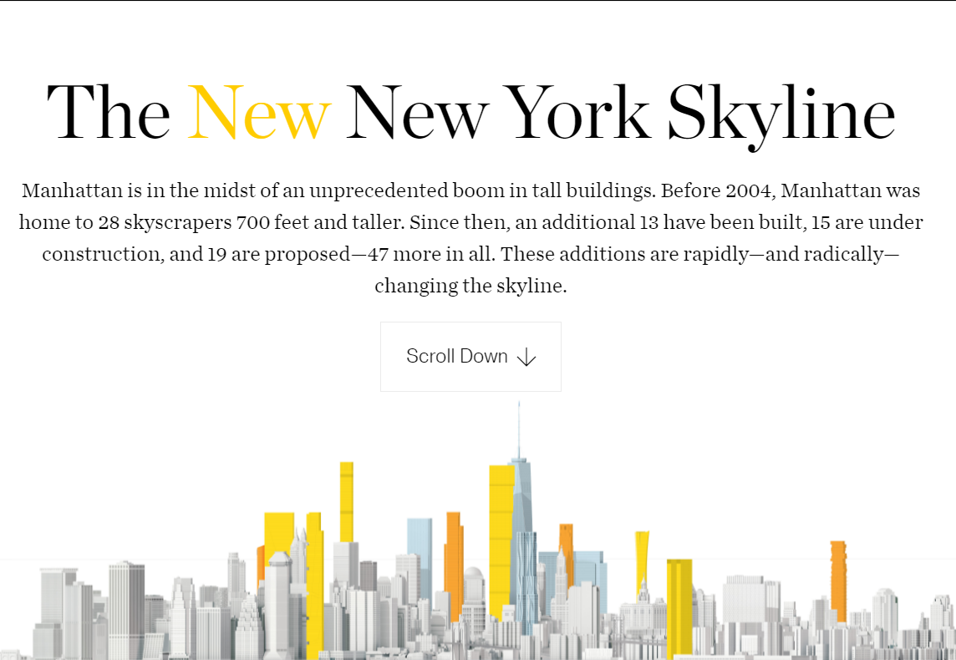
Putting it all together
How is hue used for selection, association, and order?
Notes:
Information graphic from the NYT.
Selection: If a change in a variable allows some elements to be selected from among the other elements. It uses hue (both in the title and the skyline) to separate the new skyline from the existing skyline (shown in gray)
Association: If elements can be grouped through a change in this variable, despite being different in other ways. Again, it uses hue. It associates the buildings that are recently completed (blue), in-progress (orange), and proposed (yellow). It also associates the newest (proposed) buildings to the word new in the title.
Order: If a change in this variable supports ordered readings. It uses Hue to give a sense of progression of time (blue=completed; orange=in progress, yellow=proposed (matches to New)

Slide 18
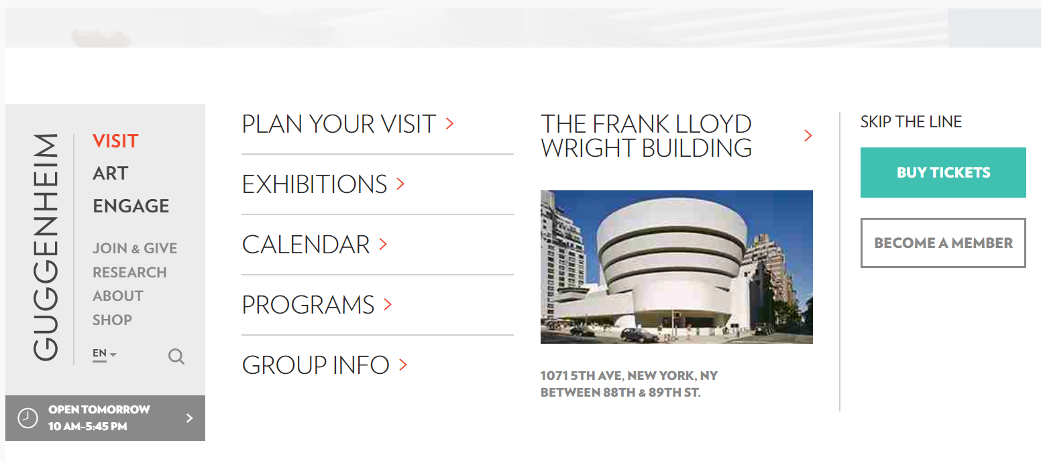
Activity 1
How are the visual variables of position, size, orientation, hue, and value leveraged for the design of this page?
Notes:
Position = 4 columns
Size = main navigational elements
Orientation = home page link, can always get back to the main page
Hue = current location, buy tickets stand out
Value = main navigation block, with a foundation.

Slide 19
Color and Guidelines
Notes:
I will dig deeper into the use of color for communication since it is so widely used in user interface design and information visualizations

Slide 20
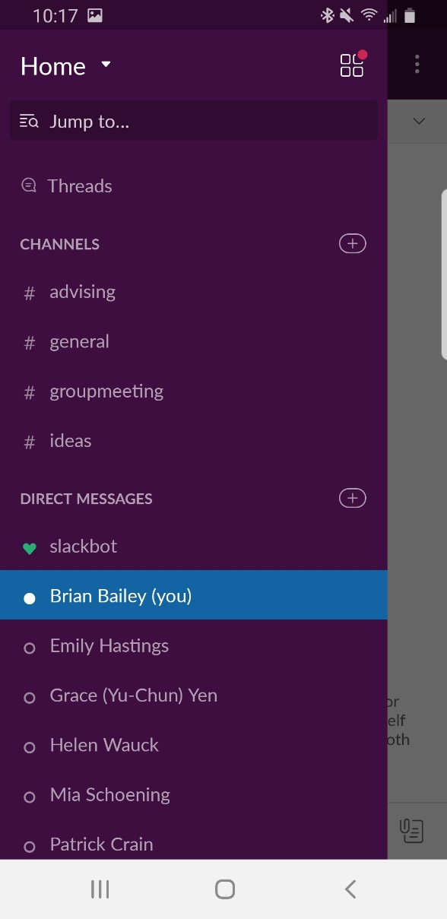
Functional Groupings of Color
Dominant use as the main color (60%)
Secondary use to offset areas, such as nav bars and selections (30%)
Accent use to prioritize elements, such calls to action (10%)
Neutrals use for text and other areas
Notes:
60-30-10 rule is a rough guideline.

Slide 21
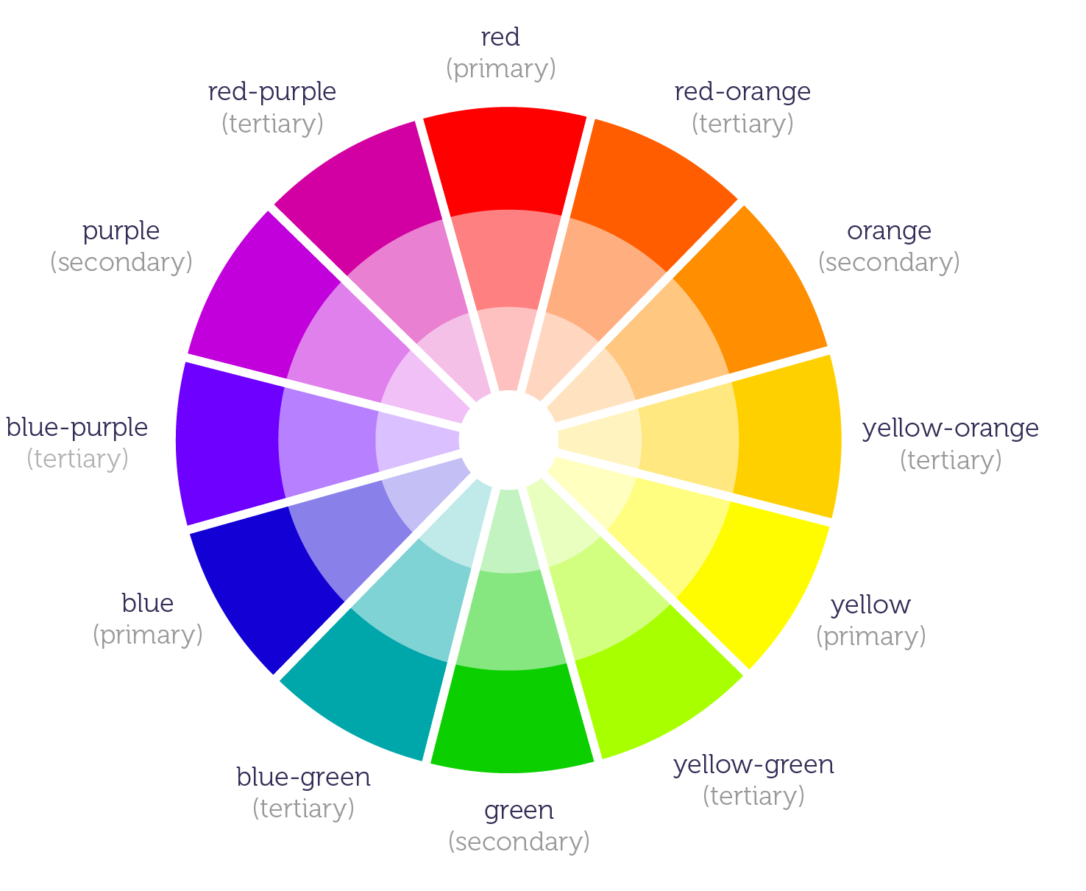
Guideline 1: leverage known schemes for choosing colors
Notes:
12 color wheel that can be used to demonstrate different schemes for color selection.
Warm vs. cool
Hues with most lightness at the innermost ring vs. hues with the least lightness at the outermost ring
I will show examples of different color schemes that will help you select up to 4 colors that go well together. Picking colors can be a challenging task and you must consider the communication goals of the design and select a scheme that helps to accomplish those goals. In many cases, only one or two colors are needed.

Slide 22
Monochromatic scheme
Notes:
Pick any hue on the color wheel, vary its value (brightness). Creates visual separation between the elements while also providing harmony in the presentation. You can typically get up to 7 distinguishable colors using this scheme. For novices, I suggest using this scheme.
Use the darkest color in the set as a dominant color and the others as secondary and accent color.

Slide 23
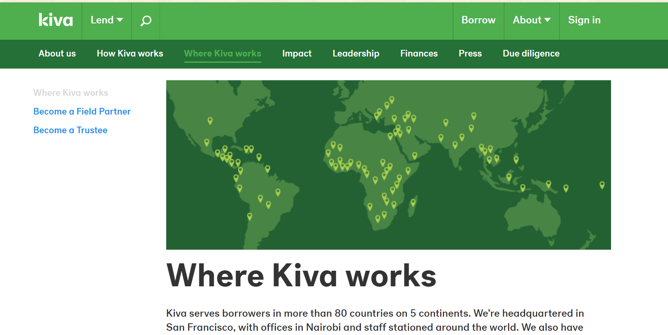
Kiva uses a monochromatic scheme to separate primary and secondary navigation regions and to create layers on the map.
Notes:
Advantage: simplicity and can create up to 7 distinct colors. Particularly useful for data presentations.
Disadvantages: does not produce contrast for things like call to action (join, sign up). For example, the Sign In link in the top right does not stand out. It also is not an exciting scheme.

Slide 24
Complementary scheme
Notes:
To create a more vibrant presentation, you want to incorporate contrasting colors.
A complementary color scheme yields two colors that provide contrast but also fit together. Pick colors that are oppose each other on the color wheel. Use one color as the dominant color (typically the cooler color as dominant color) while using the other color to create contrast and draw attention.

Slide 25
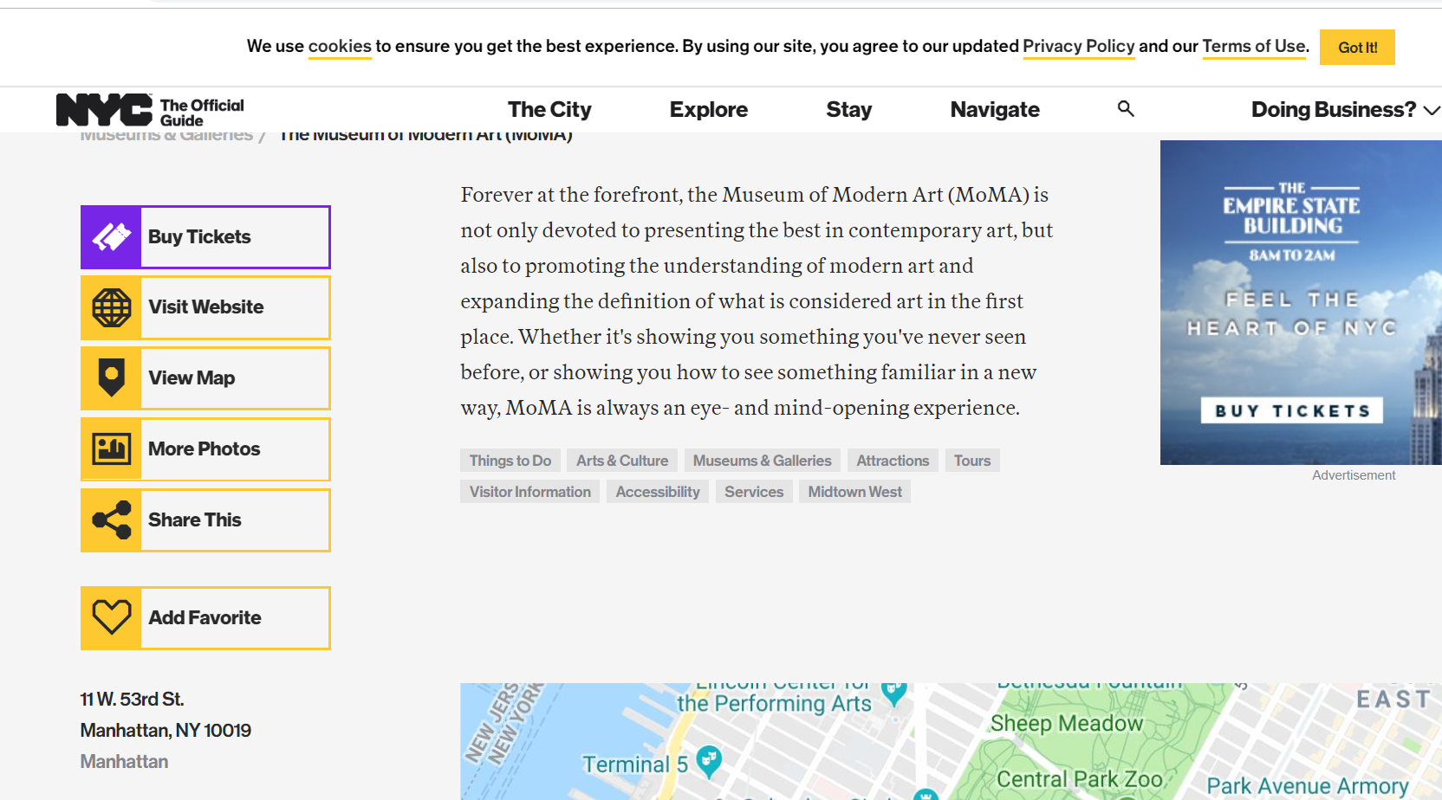
MoMA uses a complementary scheme to identify current location within the site
Notes:
MoMa site uses a complementary scheme for the navigational elements on their site. It uses the cool color (purple) to show navigation location and uses the warmer color to other destinations, as well as the action item in the upper right.
Advantage: Creates a lively presentation and visual interest.
Disadvantage: produces only two colors (though can always include neutrals, as done here)
Can be difficult to get the right balance. The cooler color is typically dominant, while the warm color serves as the contrasting accent color. This design is unique because it does the opposite. Expertise allows you to break the rules.

Slide 26
Analogous scheme
Notes:
If you want 3 different hues, you can apply an analogous color scheme. You select any three adjacent colors on the color wheel. The center color of the trio typically serves as the dominant color and the two colors on either side serve as the secondary and accent colors.

Slide 27
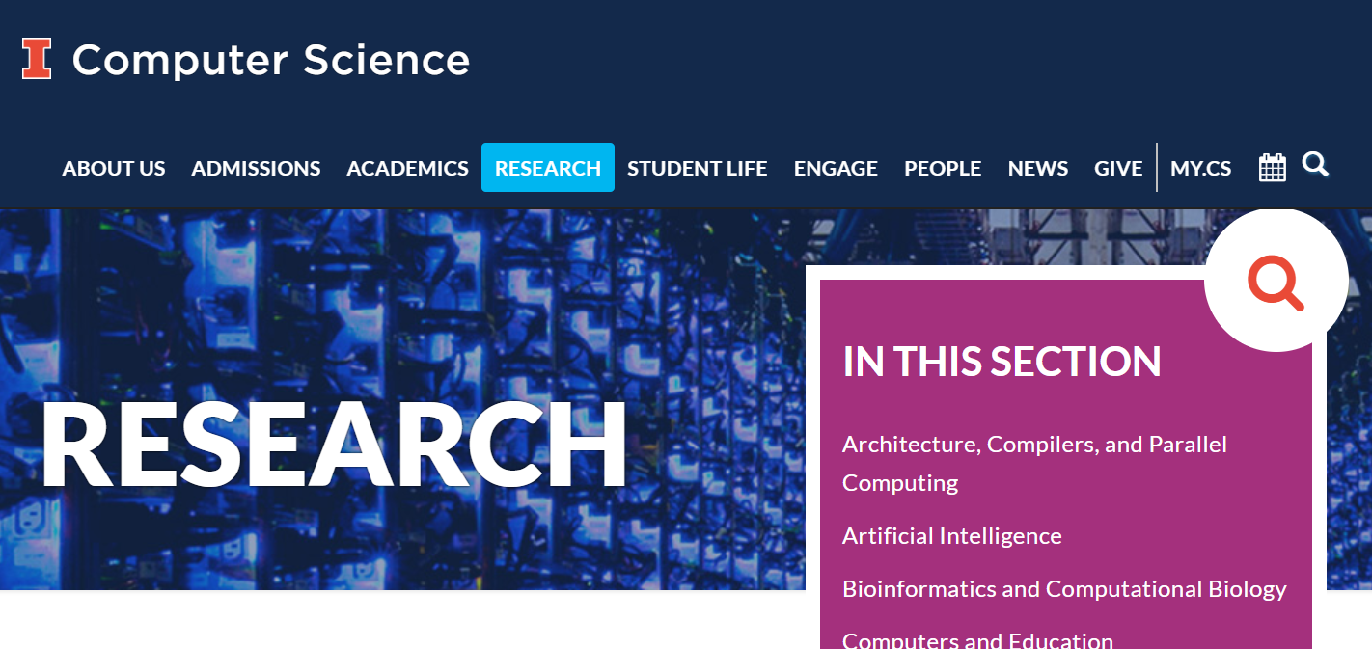
The CS website used a color scheme that was close to an analogous scheme.
Notes:
The CS department website uses a color scheme that is close to analogous.
Advantage: Three colors that create harmony in the design.
Disadvantage is that it is difficult to create contrast. None of the colors stand out from the others and the resulting design does not creating strong visual interest.

Slide 28
Triadic scheme
Notes:
Also produces three colors. If an equilateral triangle was drawn over the color wheel, its corners would touch three colors. The colors it touches form a triadic scheme. To use a triadic effectively, let one color dominate (one of the cool colors) and use the others as secondary and accent colors.

Slide 29
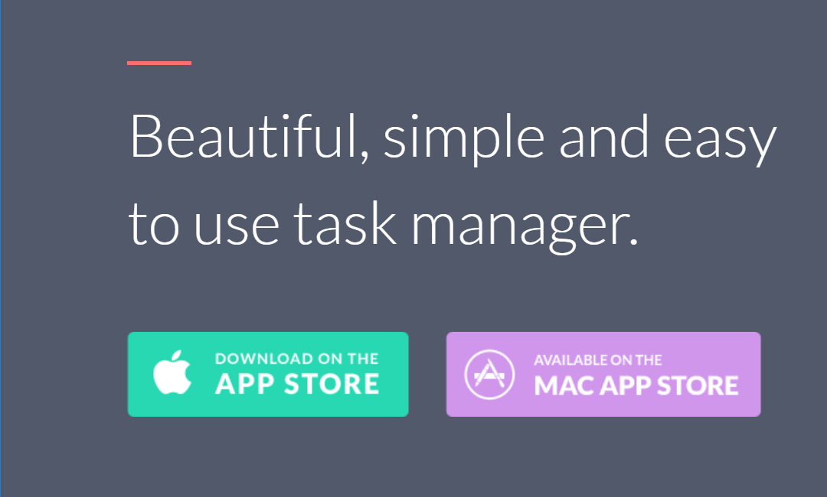
Taasky uses a triadic scheme to add visual interest to the content
Notes:
Advantage: Three colors to use, creates more visual interest than an analogous scheme, and still produces a harmonious design.
Disadvantage: Does not use complements, so no one color strongly stands out from the other two. Can be hard to find the right balance between them.

Slide 30
Split Complementary scheme
Notes:
In a split complementary scheme, start with any base color on the wheel (typically cool color) and use that color as the dominant color. Find its complement, and use the two colors on ether side of the complement to serve as secondary and accent colors. The scheme produces either one cool + two warm colors or one warm + two cool colors. Generally go with the first set.

Slide 31
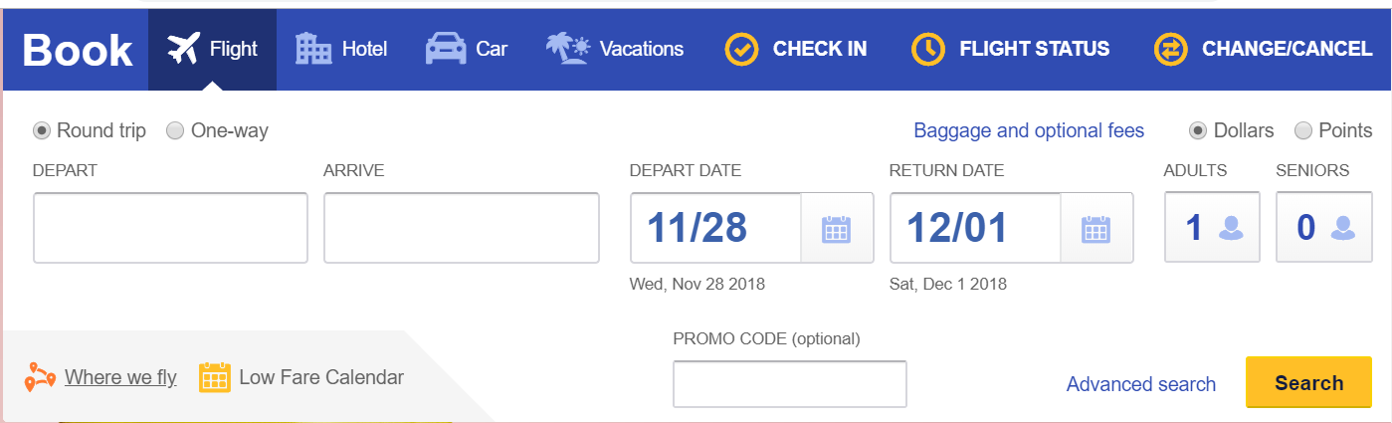
Part of the Southwest site uses a split complementary scheme
Notes:
Advantage: Three colors that form a harmonious design. Because it is close to a complementary scheme it can be applied to draw attention to some elements.
Disadvantage: If the scheme uses a warm dominant color it can be especially difficult to find the right balance of the three colors.
The other disadvantage is that the accent colors will not stand out as much as a true complementary scheme.

Slide 32
Discussion
Variations and additional schemes (e.g., rectangular)
Borrow from existing user interfaces and use online color search tools (e.g., http://adobe.color.com)
1 in 20 people have color deficiency; e.g., 8% men and 1% women have red-green color deficiency
use color-blind safe palettes and incorporate additional variables such as shape and value into the graphic design
Notes:
Important to understand and be aware of color blindness because it affects about 1 in 12 people, which is a reasonably large population. There are other forms of color blindness and in rare cases, people cannot differentiate any colors at all. Inherited through missing or bad photoreceptors or acquired through disease, aging, or drug side effects

Slide 33
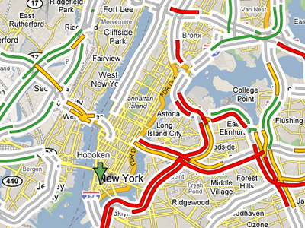
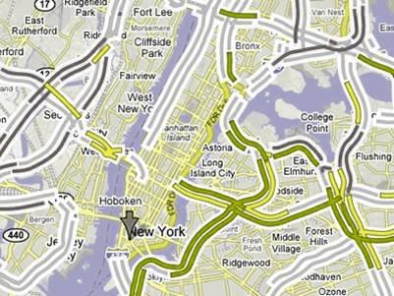
Example: Map with traffic flow
Original
Deuteranopia (red-green deficiency)

Slide 34
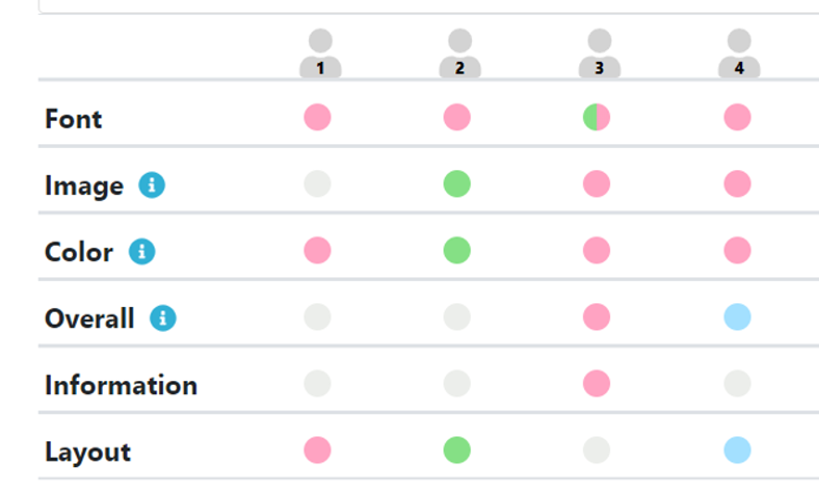
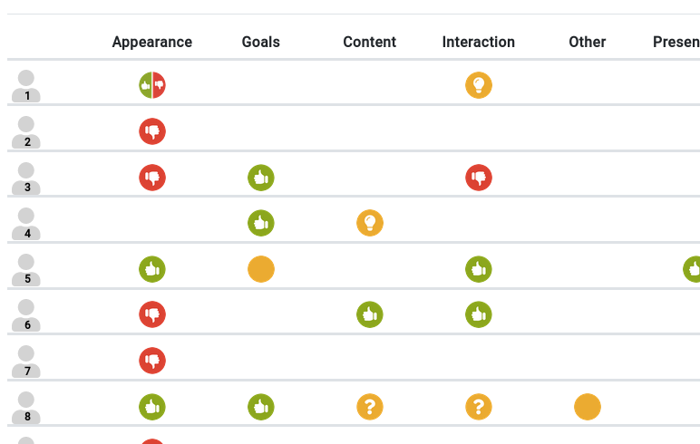
A prototype of a feedback visualization tool. The colors for the circles were light and the icons were all the same shape. Hard to differentiate, especially for users with color deficiency.
Revision: new color scheme, saturation increased, and shapes incorporated into each icon to reinforce its category. Easier to differentiate the graphical icons.
Notes:
A color-blind safe palette would help select two colors that are not red and green or subject to other forms of color deficiency

Slide 35
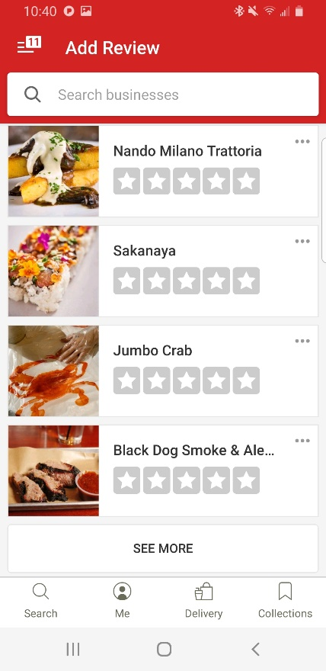
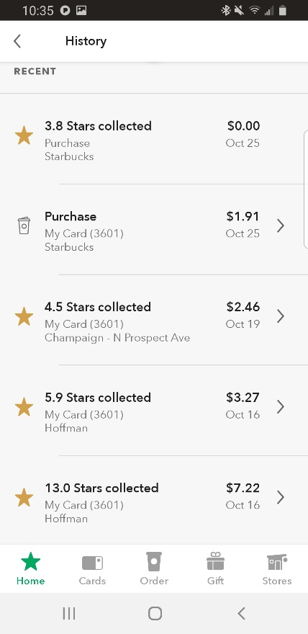
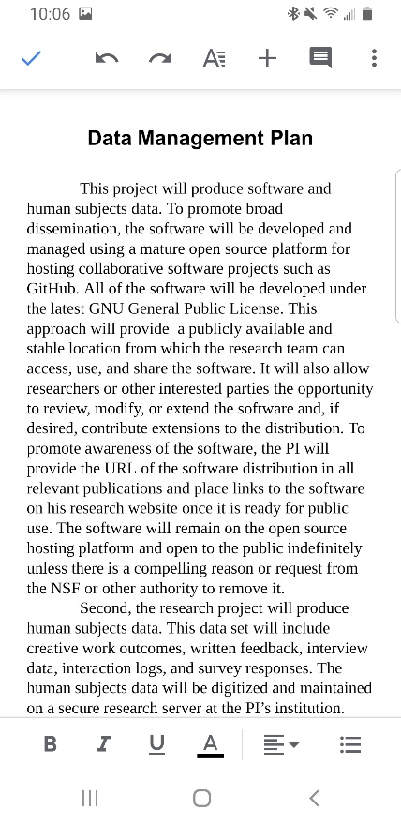
G2: Use as few colors as possible
One color, minimal color, or only neutrals will often suffice. Try monochromatic with a complement for calls to action.
Notes:
Too many colors appear complex, cluttered, and distracting
The 60% + 30% + 10% principle is the best proportion to reach balance among colors.

Slide 36
G3: Avoid saturated colors
Saturated colors cause visual fatigue because they overwhelm the photoreceptors
Use pastel colors (less saturated, less bright)

Slide 37
Saturation = 38%; Value = 50%
Saturation = 47%; Value = 25%

Slide 38
G4: Change the defaults
Default color scheme for Excel bar chart
In grayscale
Notes:
1. The default colors have the same brightness value. When printed in grayscale (most common), they cannot be differentiated.
2. Red is typically associated with error and should not be the first choice in a data presentation.
3. Red and blue does not follow any of the basic color schemes

Slide 39
Use monochromatic scheme for harmony
Use complementary scheme for contrast
Both schemes work in grayscale
Notes:
A monochromatic scheme provides a more usable color set for data presentation. First pick a single hue that you want, and then adjust the brightness to create multiple colors with as much as separation as possible. I show example with 2 colors here, but can use this strategy to create at least 5 differentiable colors and will maintain separation when printed in grayscale.
Use a similar technique to create contrast, and make one item stand out relative to another. In that case, you can use a warm color relative to a desaturation of that color (gray of similar lightness). Or you could use a two colors selected from a complementary scheme.

Slide 40
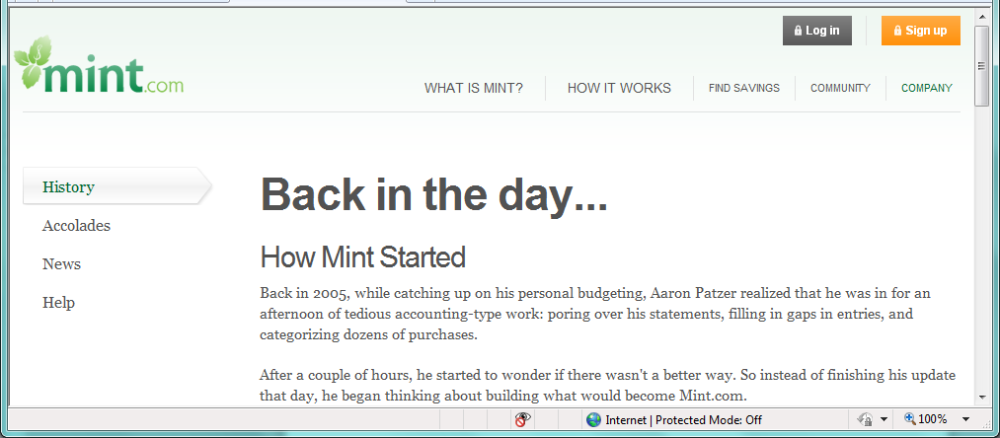
G5: Use color to draw attention
Notes:
Eye is drawn to the orange in the upper right

Slide 41
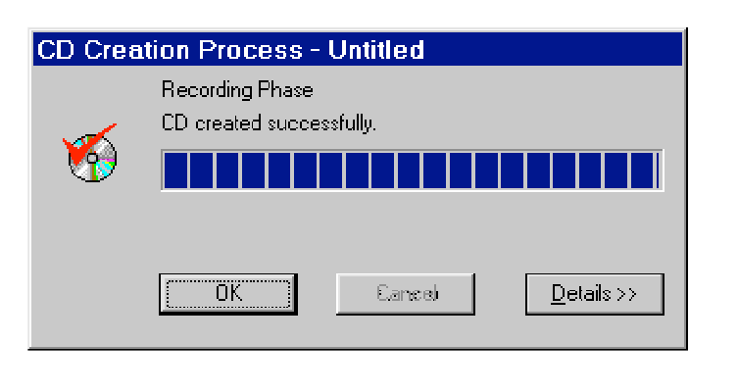
G6: Be Consistent with Expectations
Example borrowed from Rob Miller’s course notes on visual design

Slide 42
Activity 2
a) Which of the color schemes discussed was applied (if any)?
b) How else do the color choices satisfy the guidelines discussed?
https://www.nationalgeographic.com/new-york-city-skyline-tallest-midtown-manhattan/
Notes:
A. What color scheme (split complementary)
B. The 3 colors are not fully saturated or bright, minimally applied, and color is used to draw attention
Yellow (saturation = 234, Value = 132)
Orange (saturation = 222. value=140)
Blue (saturation= 165, value = 141)

Slide 43
Composition Guidelines
Simplify
Contrast
Repetition
Alignment
Proximity
Balance and symmetry
Notes:
Choosing which visual variables to modify are lower-level decisions that can be made independently; whereas a designer typically wants to make decisions that achieve higher-level meaning. Principles of visual composition can help achieve that higher-level meaning

Slide 44
G1: Simplify
“You know you’ve achieved perfection in design, not when you have nothing more to add, but when you have nothing more to take away.”
- Anotine de Saint-Exupery (1900 – 1944)
Notes:
This quote summarizes the principle of simplify. <read quote>. Analogy to course projects (what can we throw out). This principle of simplification can be achieved by …. < next >

Slide 45
By Reduction
Notes:
Reduction means that you eliminate whatever isn’t necessary. This technique has three steps: (1) decide what essentially needs to be conveyed by the design; (2) critically examine every element (label, control, color, font, line, etc.) to decide whether it serves an essential purpose; (3) remove it if it is not essential.
Apply this principle of reduction to the default chart produced by excel in the upper left. Edward Tufte refers to the decorations as CHART JUNK. Communication to ink ratio. Want it to be as large as possible. Can eliminate the horizontal lines and vertical tick marks without sacrificing clarity.

Slide 46
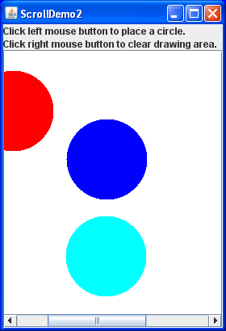
By Combination
Scroll bar
Title bar
Notes:
Simplify by combining multiple functions into a single form. For example, the “handle” in a scroll bar serves three functions. It affords changing the viewport, indicates the position of the viewport relative to the entire document, and indicates the fraction of the document displayed in the viewport. Similarly, a window’s title bar plays several roles: label, dragging handle, and location for window control buttons.

Slide 47
G2: Contrast
Direct user attention to design elements
choose appropriate visual variable(s)
exploit the full range (or length) of the variable
distribute to maximize perceptual distinction
Use sparingly
Notes:
To achieve contrast in the user interface, choose the right visual variable to represent it, most common is use of value, orientation, position, and size. Once you’ve chosen a variable, determine the minimum and maximum value you can use, and exploit the whole range (use as much length as possible). For position, this means using the full width of the window; for size, it means using the smallest and the largest practical sizes.
OLD
Choose variable values to make sharp, easily perceptible distinctions between them. Multiplicative scaling (e.g., size doubles at each successive level) rather than additive scaling (e.g., adding equal number of pixels at each successive level).

Slide 48
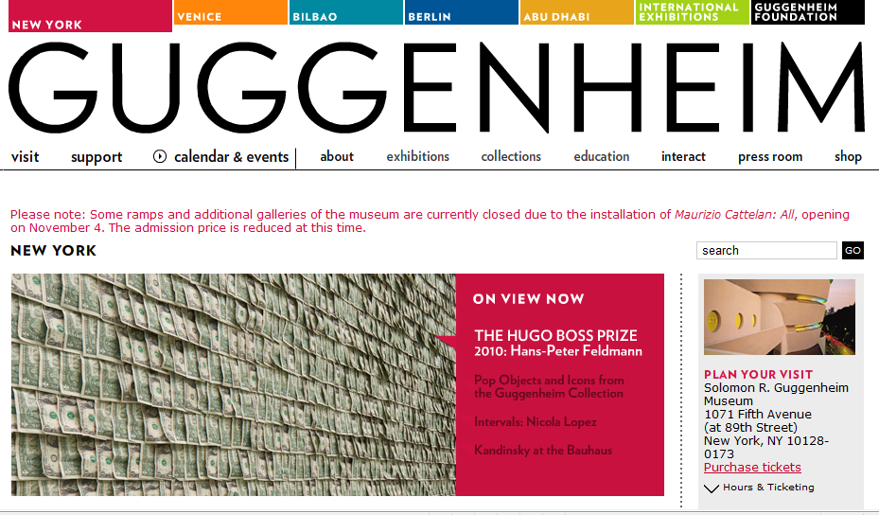
Notes:
Here it is obvious: the lettering at the top really stands out. It was not just a little bigger, it was like 200-point font.

Slide 49
G3: Repetition
Repeat variable values such as hues, shapes, sizes, and positions; and patterns
promotes unity, cohesiveness, and consistency
Notes:
And regular patterns of these variable values

Slide 50

Notes:
What is repeated? The white color? The color connects the label iPod to the device. This tells you what it is. What if the label were black? It connects to the silhouette, not the device. It conveys a different and less effective meaning.

Slide 51
G4: Alignment
Position elements with purpose
at a minimum, align elements on the edges and align the baselines of the text
minimize lines of alignment
Imposes order on the design
Notes:
Every element in a design should be intentionally placed. Do not place elements haphazardly. Fewer lines of alignment result in the perception of simpler designs.

Slide 53
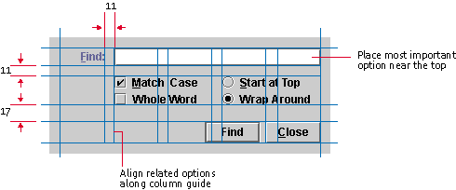
Alignment in a Find Dialog
From http://java.sun.com/products/jlf/ed2/book/HIG.Visual2.html
Notes:
A grid is one effective way to achieve alignment. Here is a find dialog with the grid lines.
Checkboxes and toggles:
The components have less space vertically and more space horizontally to create logical groupings.
The checkboxes are aligned to the text entry component on the left to connect the options to the text entry field.
The close button is aligned to the right edge of the text entry to create a sense of closure for the dialog.
Yet the Find button and Find label do not align to other components. This might be purposeful to help these elements stand out.

Slide 54
G5: Proximity
Position elements closer to communicate relatedness or to order in a logical sequence
Use white space for grouping rather than crowd elements together or using borders
Notes:
Similar to proximity in Gestalt theory
This creates tension because screen real estate is at a premium in many graphical user interfaces, so it’s a struggle to balance the need for white space against a desire to pack information and controls into a display. But insufficient white space can have serious side-effects, making a display more complex, confusing, and slower to scan.

Slide 55
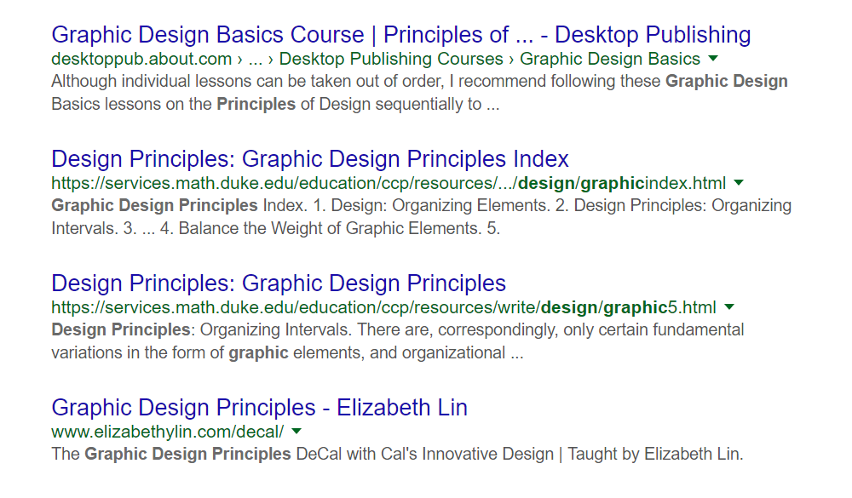
Notes:
Search results use proximity to create grouping of the results. You can place fewer results on a page, but they are easier to comprehend. Notice what you do not see, you do not see borders or field labels. The results are communicated through manipulation of the visual variables. Page titles are the most important, so the titles are displayed with a larger size, different hue, and increased brightness, plus a little but of shape (the underline upon hover). The summary is in black for good readability relative to the white background, and the URL is in green to bracket the summary. It also uses white space to separate each result without lines, borders or labels. This is the law of proximity in practice.

Slide 56
G6: Balance
Choose an axis (usually vertical)
Distribute elements ‘equally’ around axis
balance both mass and extent
Notes:
Balance rarely means exact, mirror-image equivalence. Instead, balance means that there is a perception of equal mass and extent on each side of a chosen axis. Mass is the quantity of nonwhite pixels and extent is the area covered by those pixels. We want to balance both mass and extent.

Slide 57
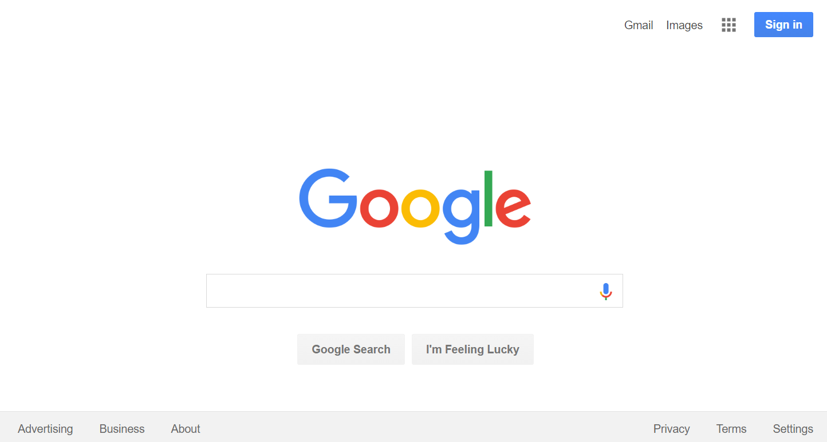
Notes:
Draw a vertical line. The amount of stuff (mass and extent) feels balanced on both sides.

Slide 58
Notes:
But if I remove the element in the lower left, it feels like tipping to the right.

Slide 59
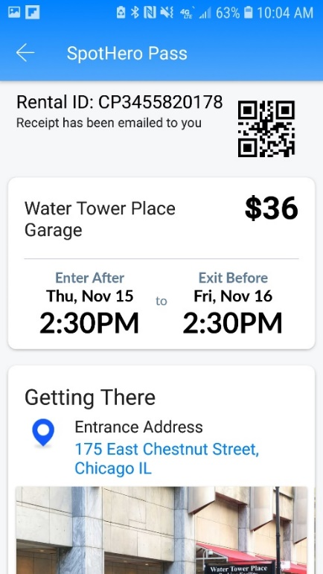
Activity 3
A user interface screen from the Spot Hero app. Describe how the screen applies any three of the guidelines discussed in lecture.
Notes:
Uses repetition (enter after, exit before, same pattern)
Uses contrast (time much larger) to highlight enter and exit times.
Uses balance (uses full width of the screen, a line drawn vertically feels like an equal amount of non-white pixels on both sides)
Avoids saturated colors
Uses few colors - only one hue in a monochromatic scheme

Slide 60
Discussion
Hard to satisfy all guidelines in parallel
e.g., positioning elements to create functional groupings might make some of those elements unreachable for one-handed use.
prioritize the principles through iteration
Discussed only a subset of design principles
Notes:
Works for difficult cultures and demographics, and communicates corporate brand.

Slide 61
In Conclusion
Visual design is important in UI design because it communicates meaning beyond the content
Discussed many guidelines today
see the guidelines in the user interfaces that you use and apply the guidelines in the work you create
good visual design will make YOU stand out
Notes:
such as projects, charts, posters, web sites, and resumes

